Slide 1

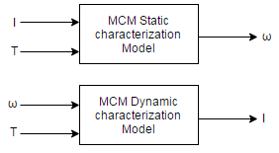
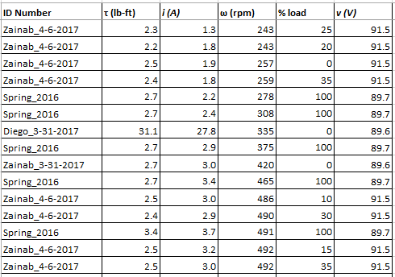
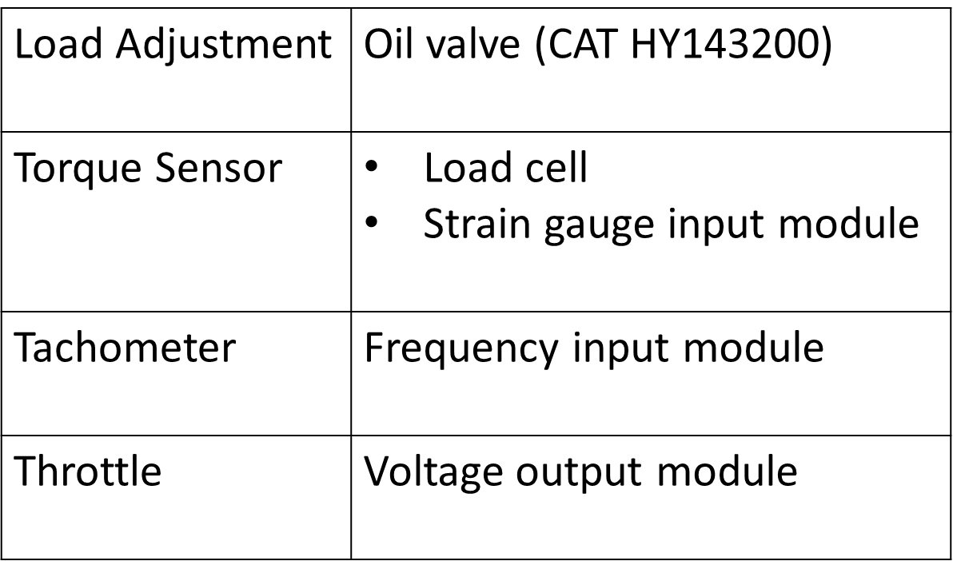
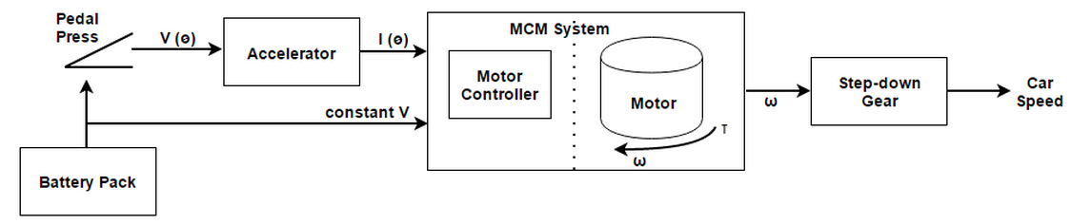
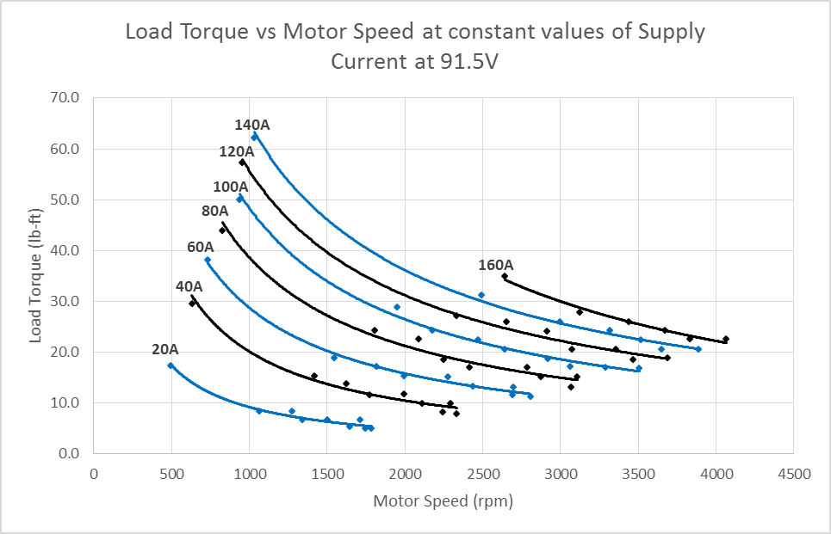
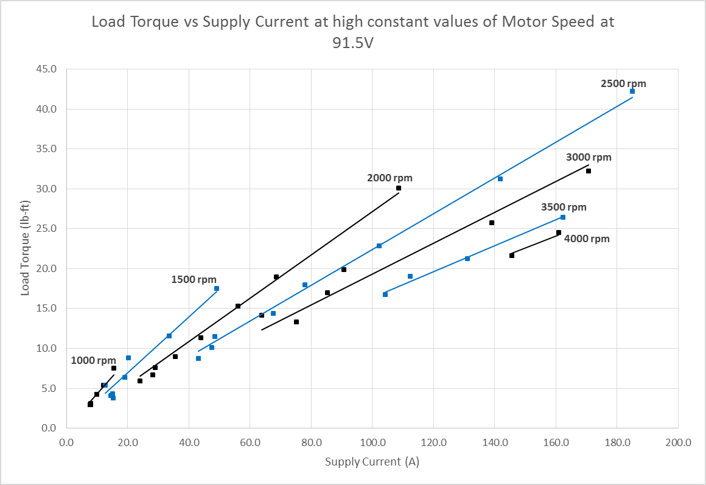
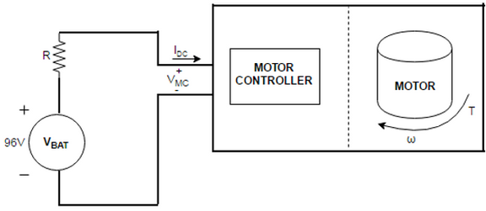
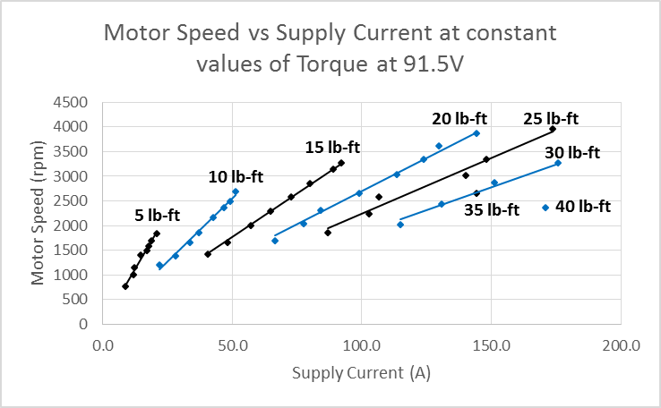
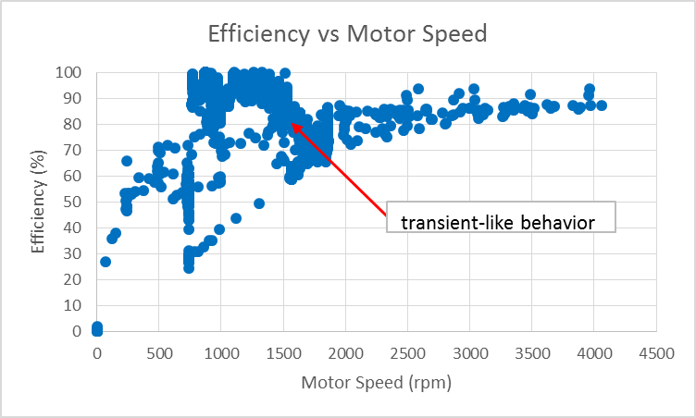
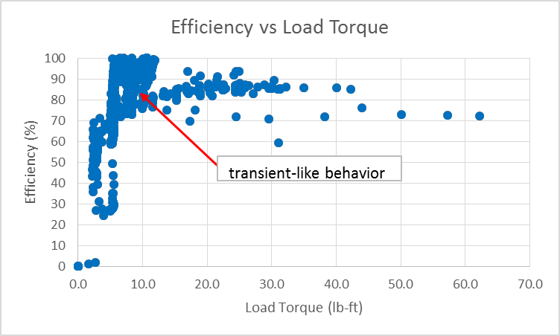
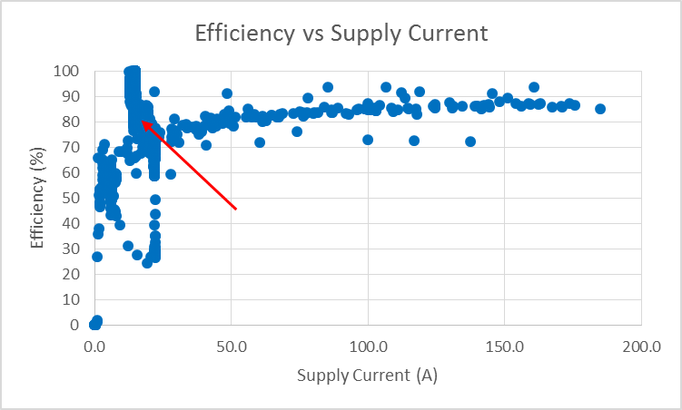
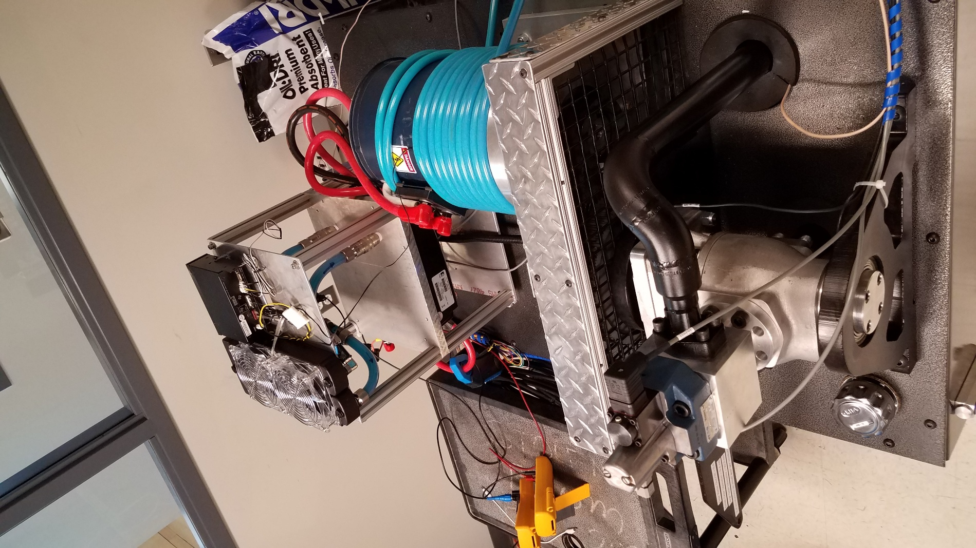

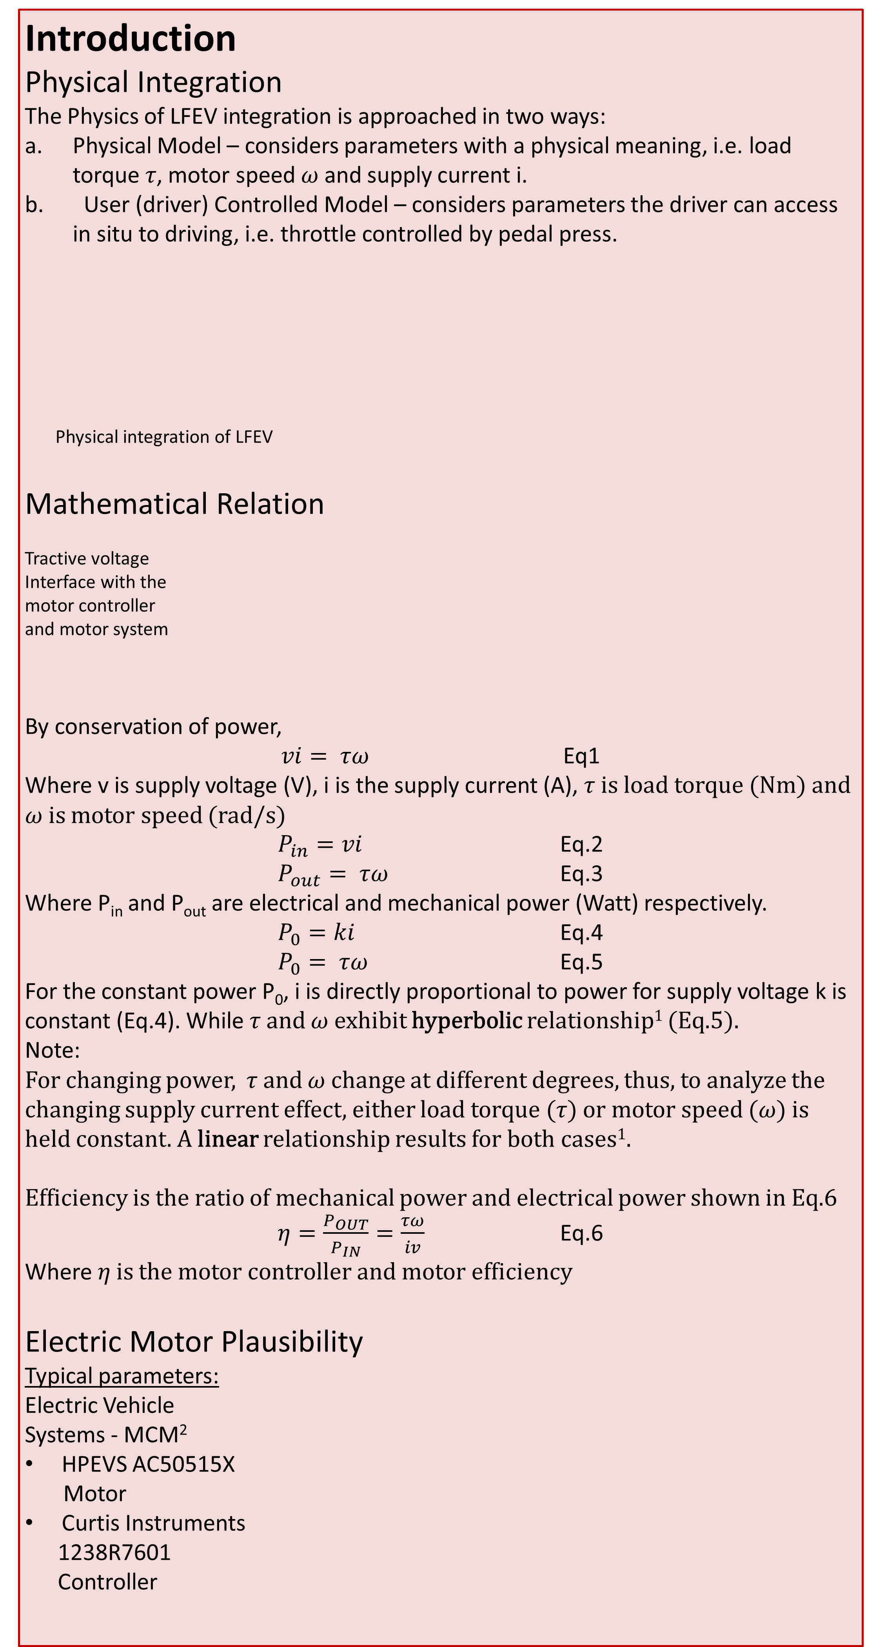
Formula Electric Vehicle
ECE 492 - Spring 2017
Physics Modeling and Cruise Control
Project Website:
http://sites.lafayette.edu/ece492-sp17/
Engineer: Zainab A. Hussein
Abstract
The Lafayette Formula Electric Vehicle project is in the 5th year for the senior Electrical and Computer Engineering seniors. The class of 2017 has reached a great milestone building from previous years, operational subsystems and driving the vehicle. Physics Modeling and Cruise Control subsystem contribution has been thesis of the physics working of the LFEV. Accurate characterization of the plausibility of our electric motor was required to set proper foundation for cruise control.
Introduction
Physical Integration
The Physics of LFEV integration is approached in two ways:
Physical Model – considers parameters with a physical meaning, i.e. load torque 𝜏, motor speed 𝜔 and supply current i.
User (driver) Controlled Model – considers parameters the driver can access in situ to driving, i.e. throttle controlled by pedal press.
Physical integration of LFEV
Mathematical Relation
Tractive voltage
Interface with the
motor controller
and motor system
By conservation of power,
$vi= τω$ Eq1
Where v is supply voltage (V), i is the supply current (A), 𝜏 is load torque (Nm) and 𝜔 is motor speed (rad/s)
$P_{in}=vi$ Eq.2
$P_{out}= τω$ Eq.3
Where P_{in} and P_{out} are electrical and mechanical power (Watt) respectively.
$P_{0}=ki$ Eq.4
$P_{0}= τω$ Eq.5
For the constant power P₀, i is directly proportional to power for supply voltage k is constant (Eq.4). While 𝜏 and 𝜔 exhibit hyperbolic relationship¹ (Eq.5).
Note:
For changing power, 𝜏 and 𝜔 change at different degrees, thus, to analyze the changing supply current effect, either load torque (𝜏) or motor speed (𝜔) is held constant. A linear relationship results for both cases¹.
Efficiency is the ratio of mechanical power and electrical power shown in Eq.6
$η=\frac{P_{OUT}}{P_{IN}}=\frac{τω}{iv}$ Eq.6
Where 𝜂 is the motor controller and motor efficiency
Electric Motor Plausibility
Typical parameters:
Electric Vehicle
Systems - MCM²
HPEVS AC50515X
Motor
Curtis Instruments
1238R7601
Controller
Dynamic and Static Model LUT³
Motor controller
and motor (MCM)
characterizations
Dynamometer System and Sensors – Huff HTH100 Dyno²
Discussion
The working range represented in the plots are:
0 to 70 lb-ft of load torque
0 to 4000 rpm of motor speed
0 to 185 A of supply current
At constant power, the 3 parameters exhibit a hyperbolic relationship, and a linear relationship at changing power, as theoretically expected.
The efficiency of the MCM system is generally expected to increase with increase in motor speed and supply current, and to a certain extent, load torque. The plotted results in the results section exhibit a transient behavior. This deviation from the expected behavior could arise from two possible sources:
The electric motor is unstable at the given low physical parameter.
The combination of data files collected at different times under different set conditions. Whereas some current (2017) raw data is cleaned for irregularities, the 2016 raw data is used as is.
Sample section of the lookup table (LUT) specific to the HPEVS AC50515X Motor used for the LFEV
Results
Conclusion
We investigated the plausibility of our electric motor and motor controller for a range of the 3 physical parameters, in relation to the physics model of how the LFEV integrates. Plausibility was established when the experimental relation of the MCM I/O was found consistent with the theoretical. A proper LUT showing what value two of the physical parameters should be, for a given supply current or motor speed. This sets a good foundation for cruise control.
Future work will investigate the reason for the transient behavior, its significance to the LFEV and a cruise control Simulink simulation for vehicle speed.
At constant current, load torque self-adjusts at a set motor speed to meet the power which the current is proportional to, resulting in hyperbolic relationship
At constant motor speed, a set increase in supply current results to an increase in load torque to maintain the given constant motor speed, resulting in linear relationship
References
₁Hussein, Zainab. Theoretical Mathematical Modeling (2017)
₂Hussein, Zainab. Report on Usefulness of Data Collected and Plausibility of the Electric Car (2017)
₃Hussein, Zainab. Static and Dynamic LUT (2017)
At constant load torque, a set increase in motor speed results to an increase in supply current to maintain the given constant load torque, resulting in linear relationship
Generally the efficiency increases with increase in motor speed, then plateaus at around 3000 rpm. Between 750-1750 rpm, a transient behavior is observed.
Acknowlegements
Department of Electrical and Computer Engineering
Richard Diego for help collecting experimental data with the dynamometer setup
Professors Nadovich and Schmult for this Physics thesis advising
Professors Boekelheide (Physics department),
Wallace and Yu for secondary advising.
Dyno setup pseudo
LFEV from which Physics
modeling data was collected
remotely through a CAN bus
Transient-like behavior
Generally the efficiency increases with increase in load torque, an optimum efficiency observed at 25 lb-ft. After around 40 lb-ft, efficiency begins to fall. Between 5-10 lb-ft, a transient behavior is observed.
Generally the efficiency increases with increase in supply current. Between 0-25 A, a transient behavior is observed.

